Slide 1

OVER THE TOP(OTT) Database
Team 18
Dimpleben Kanjibhai Patel (002965372)
Garima Choudhary (002104897)
Mridul Regmi (001090410)
Nidhi Singh (002925684)
Virendra Singh Rathore (001584432)

Slide 2

Contents
Objective​
ER Diagram​
Table level constraints
Triggers/Computed columns
Column Data Encryption
Views, Reports
Data Analysis​

Slide 3

objectives
The purpose of the database is to maintain the data of OTT platform. It will be used by administrative staff of streaming service that delivers content over the internet and will not duplicate information.

Slide 4
Business Objectives
Maintain customer data on subscriptions and watch history
Yearly reports on customer acquisition, retention and growth
Track payment records for each customer
To generate reports on popularity of actors, movies and web-series
To help provide insights on plans and subscriptions to generate maximum revenue

Slide 5
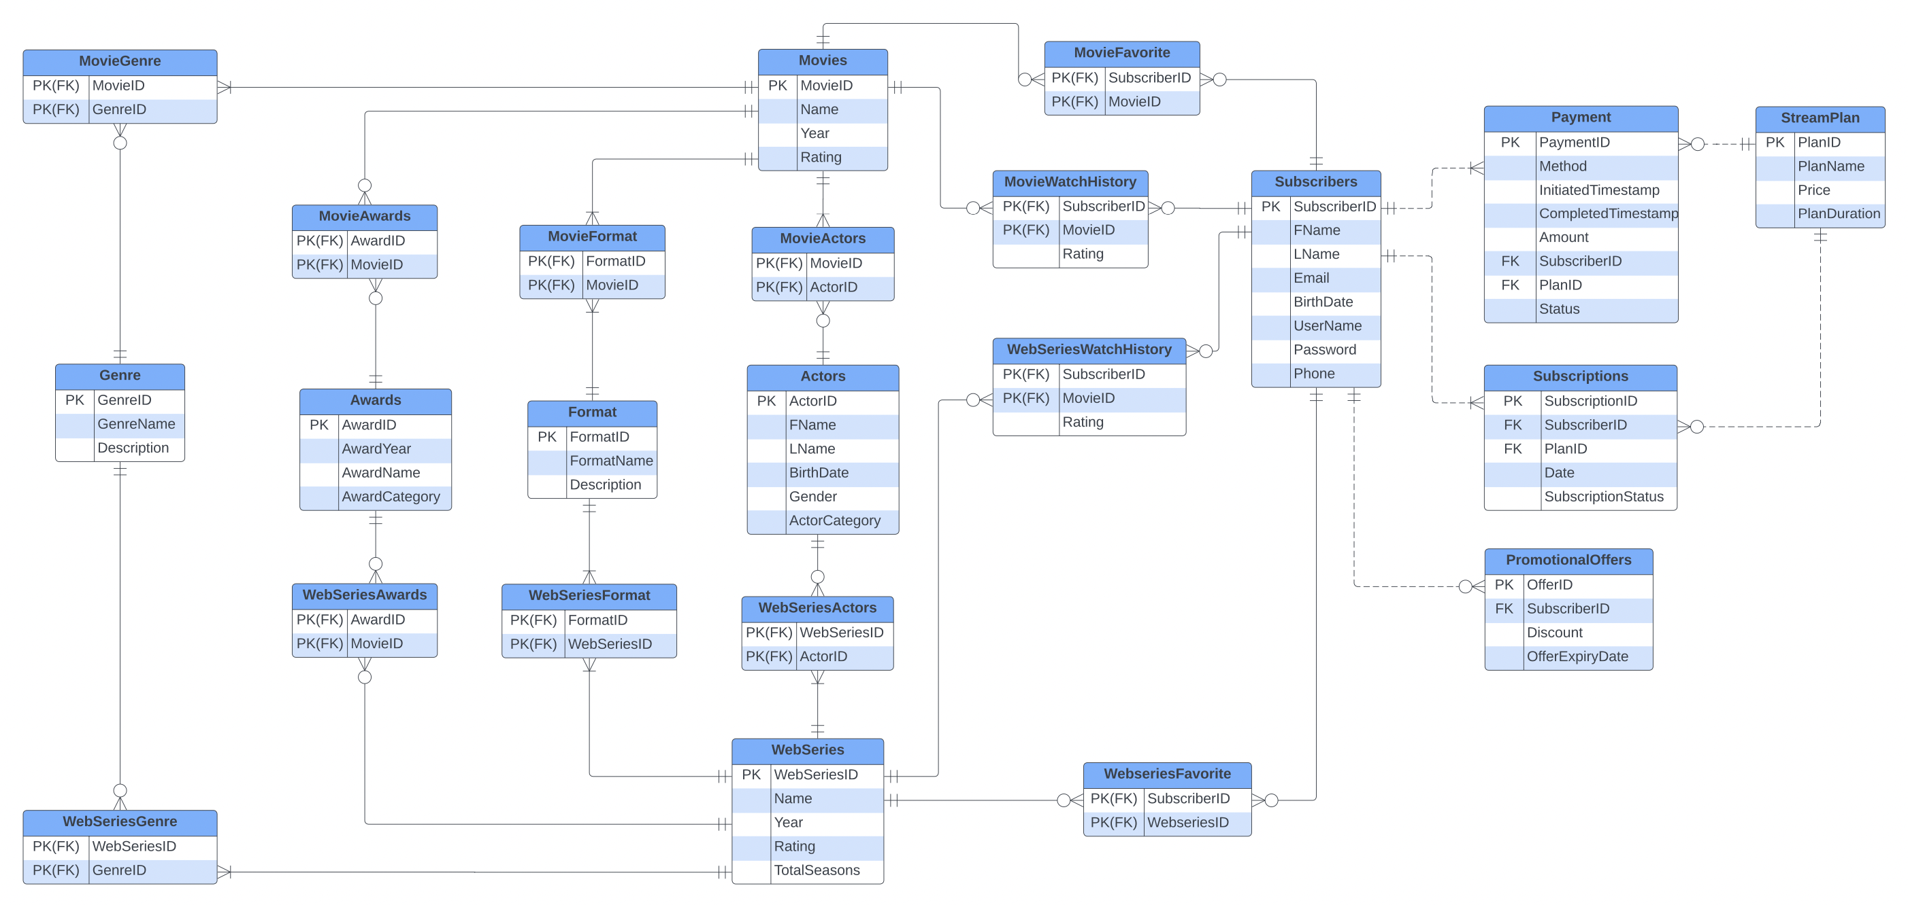
Entity-Relationship Diagram

Slide 6
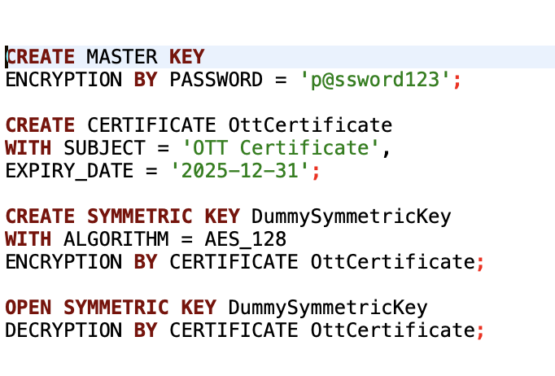
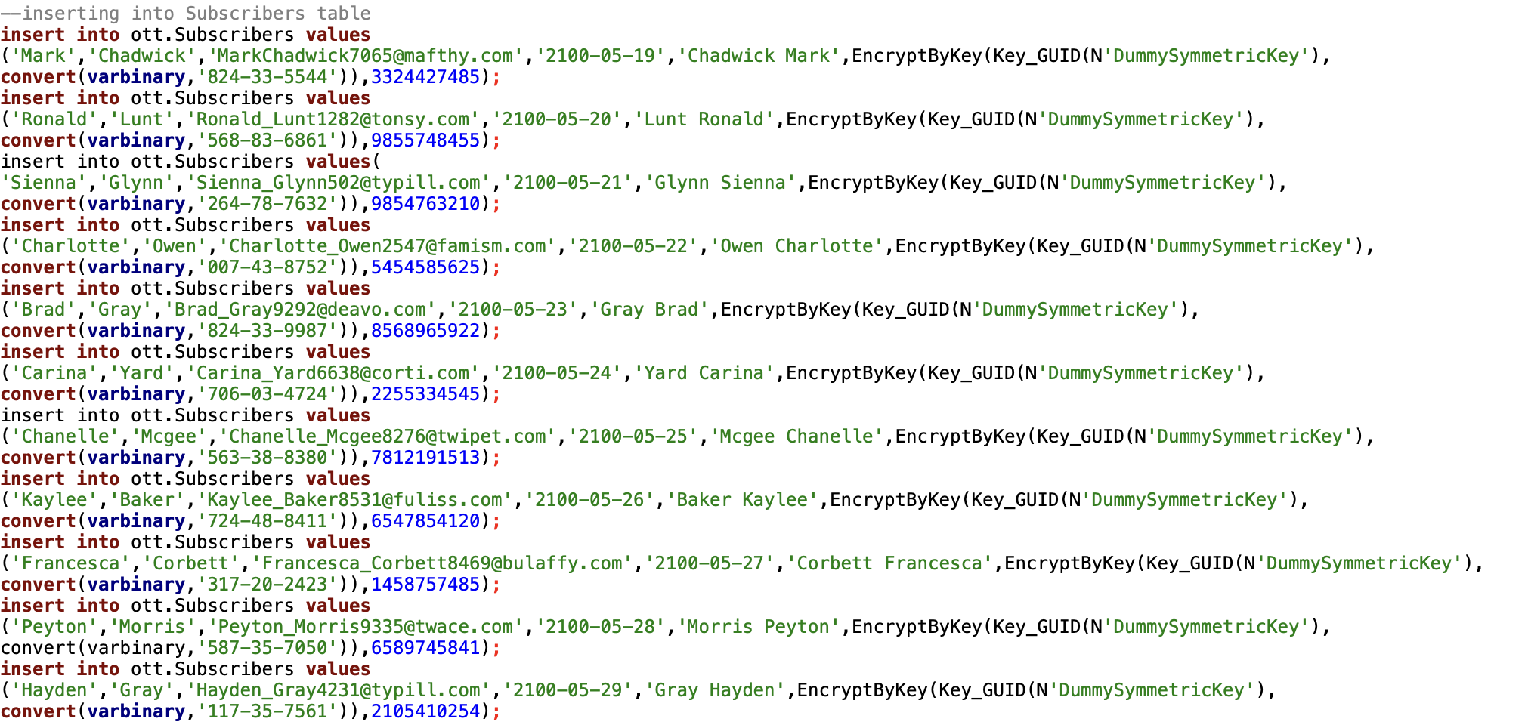
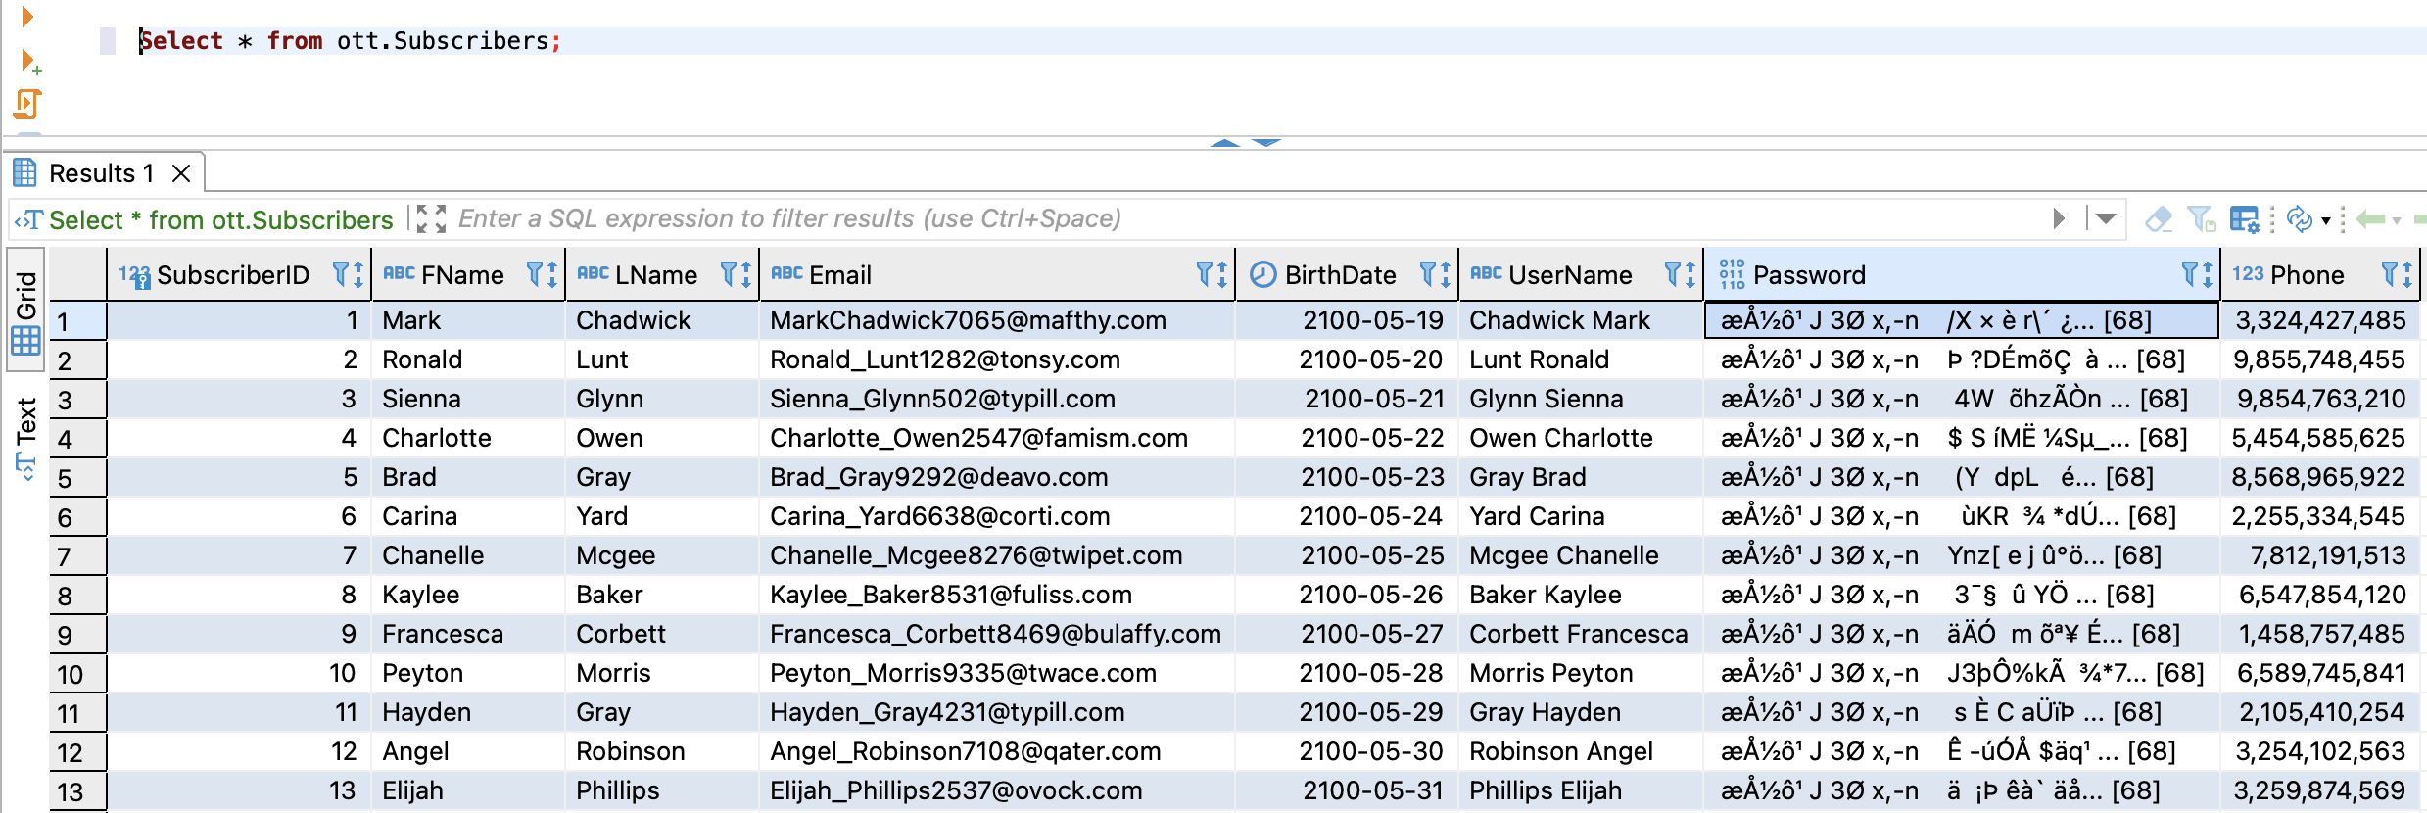
Column data encryption
Data Encryption at Database level
Data Encryption at Column level

Slide 7
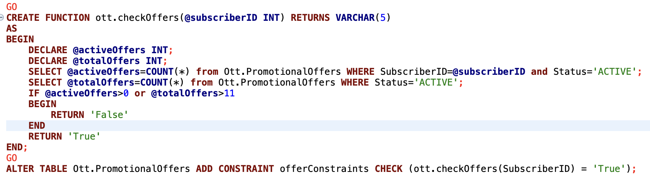
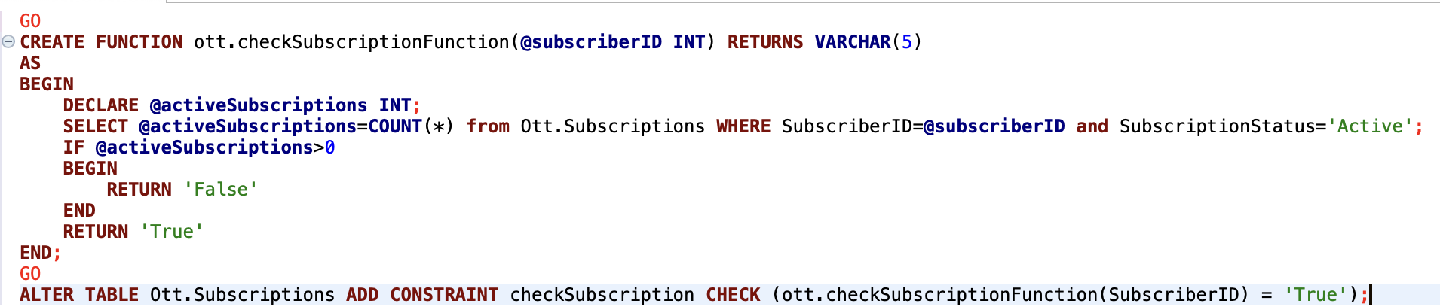
Table-Level Check Constraints
Promotional Offers Constraint: Only 12 active offers and one customer can have at most one active offer
Subscription constraint: Only one active subscription per user

Slide 8
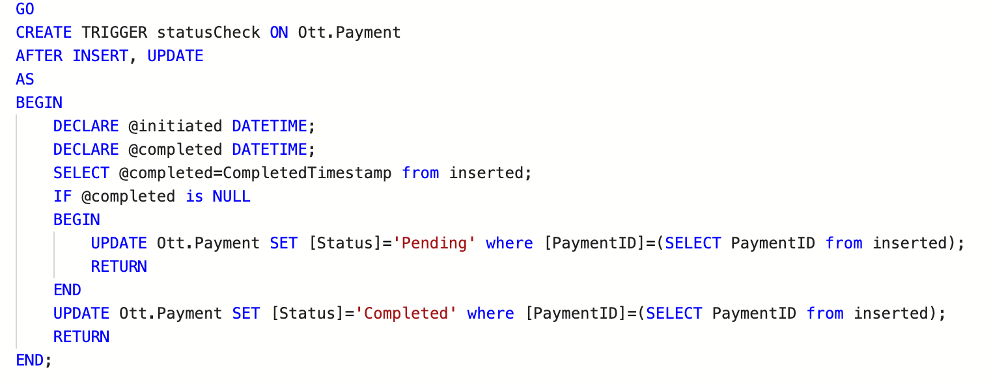
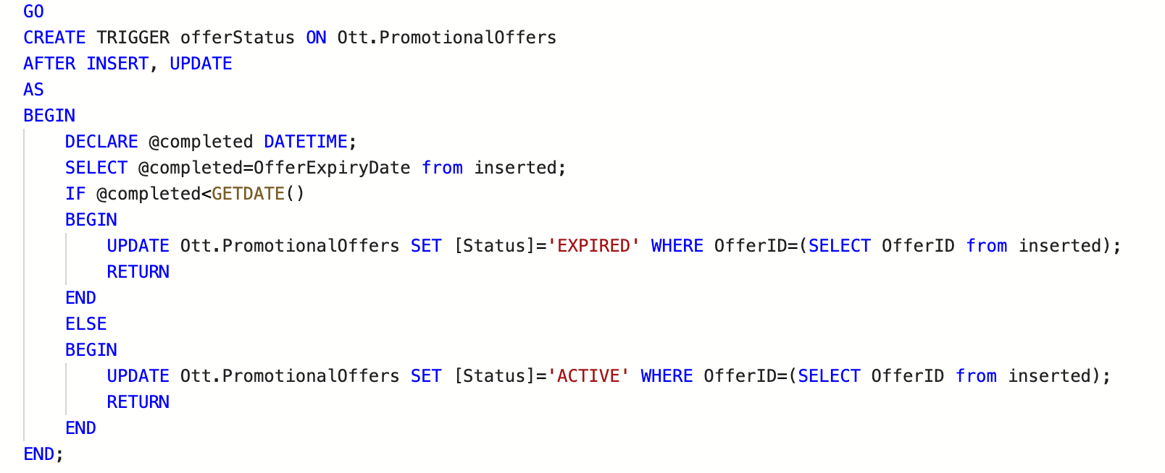
Triggers & Computed Columns
Update Status column based on payment status
Promotional Offers Trigger: Update status column

Slide 9
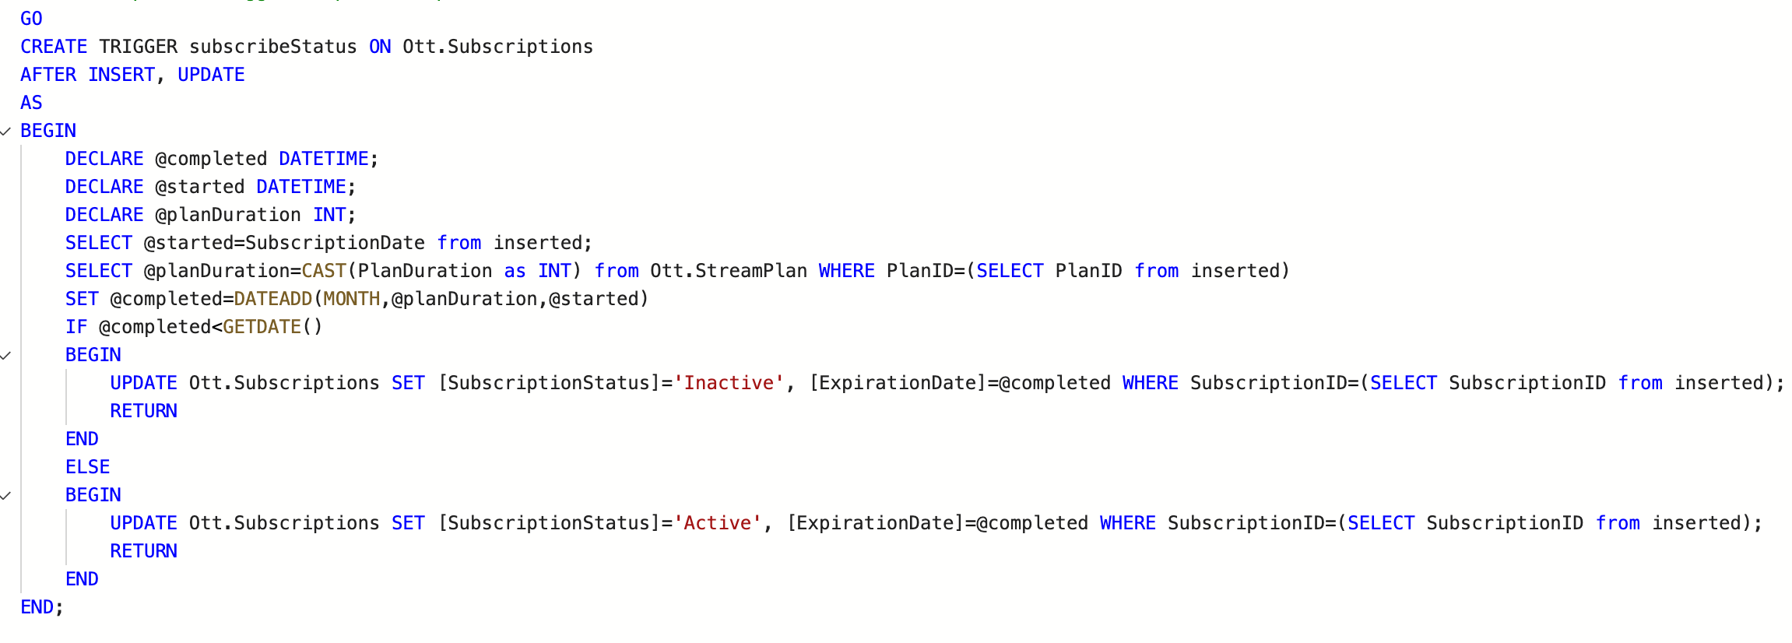
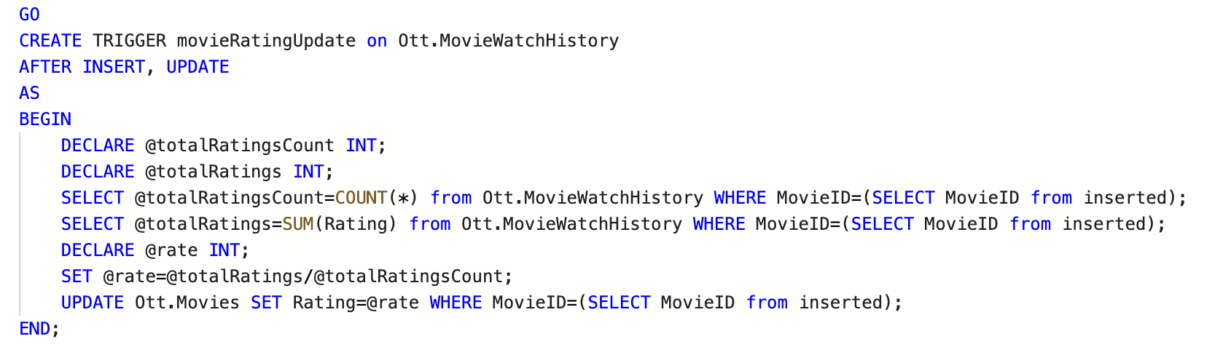
Triggers & Computed Columns
Subscriptions trigger: Populate Expiration Date and PlanID Column
Trigger for rating movies

Slide 10
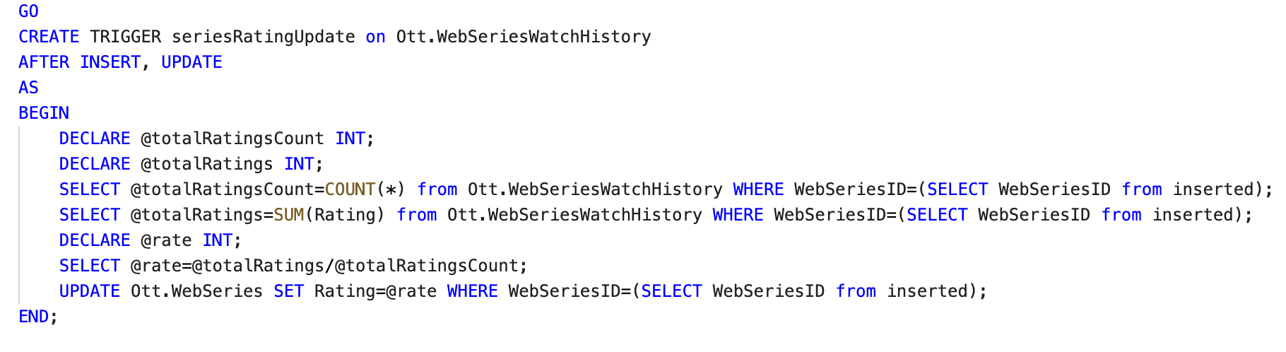
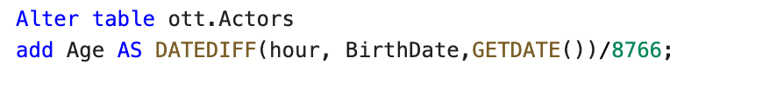
Triggers & Computed Columns
Trigger for Rating Web Series
Calculating Actor's Age

Slide 11
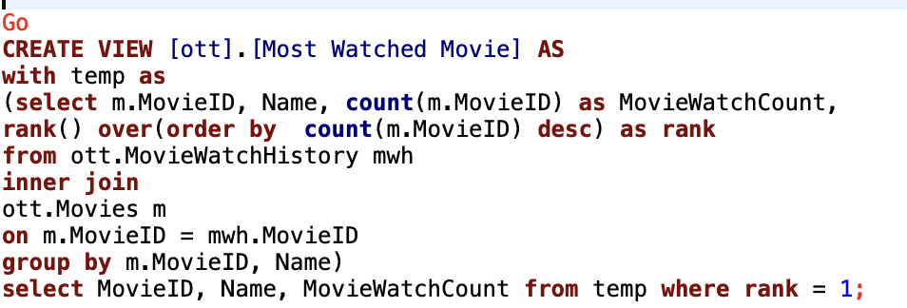
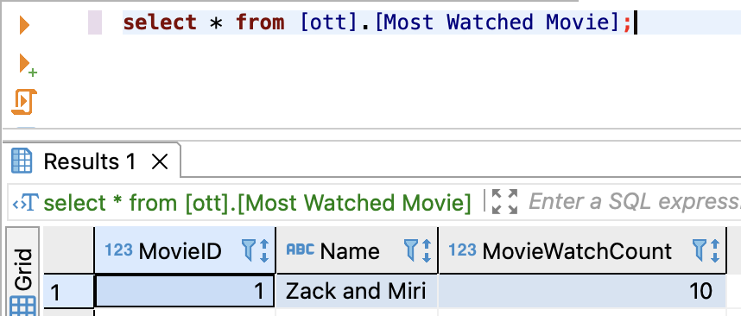
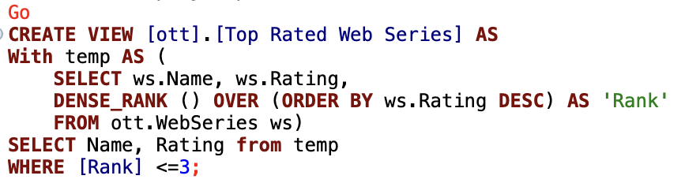
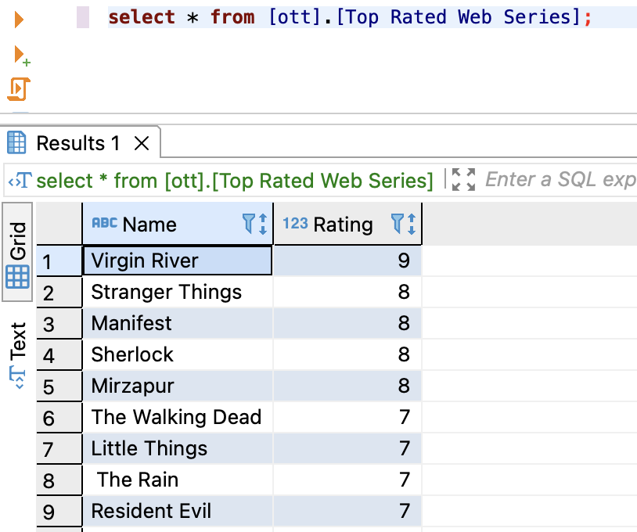
Views
View to display Most watched movies
View to display Top 3 rated web series

Slide 12
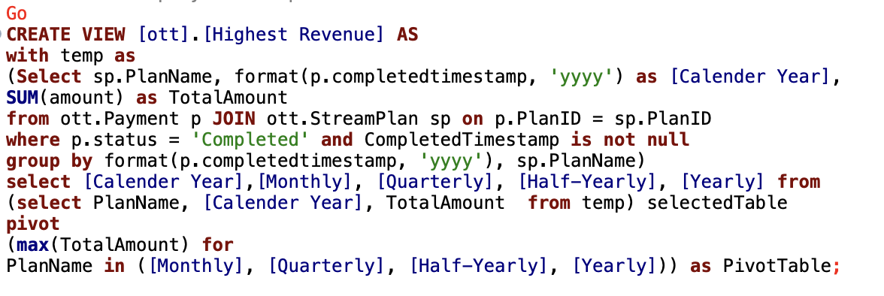
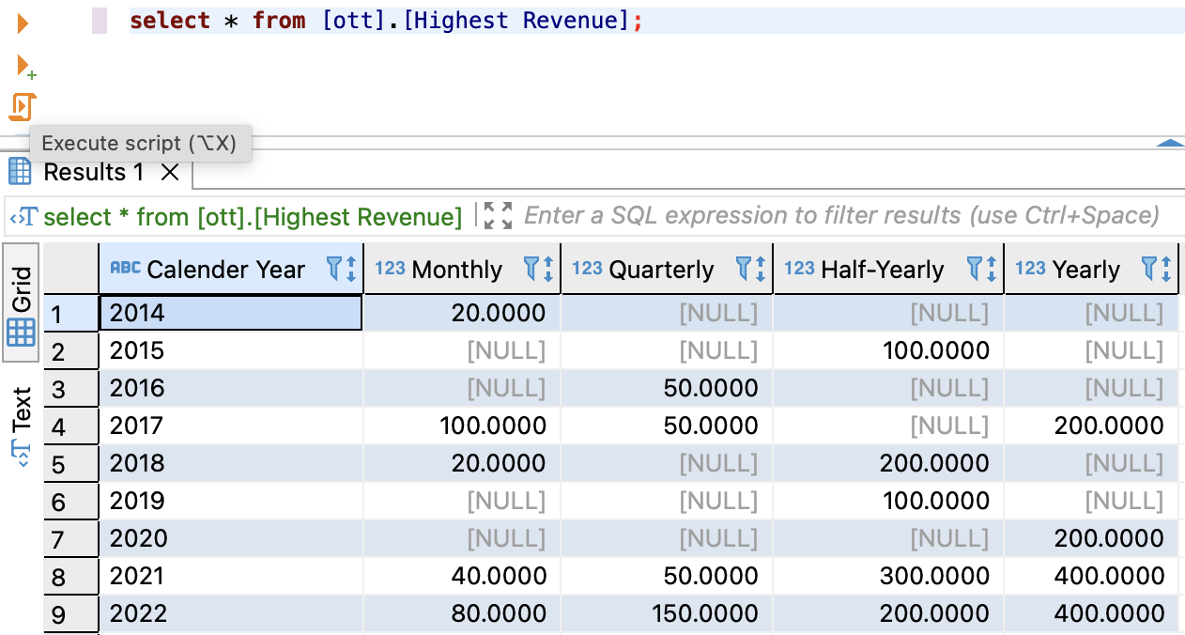
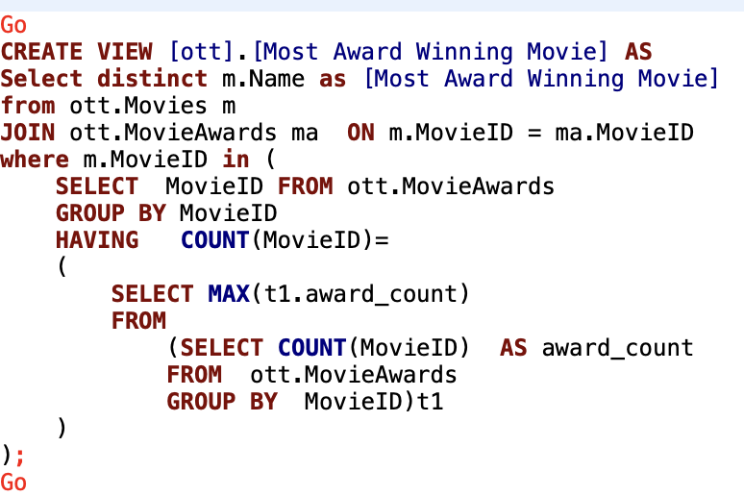
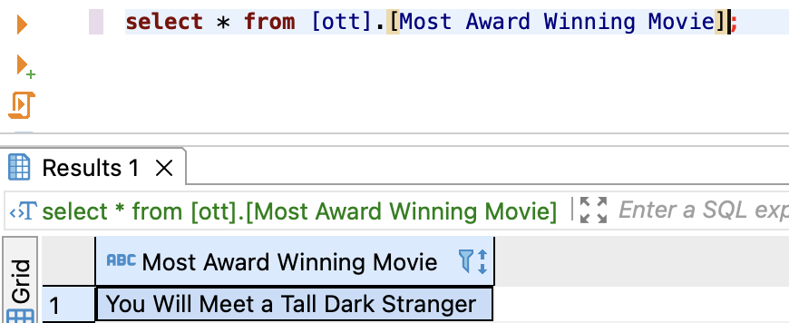
Views
View to display Stream plan and Yearly Total Revenue
View to display Most Award-Winning Movie

Slide 13
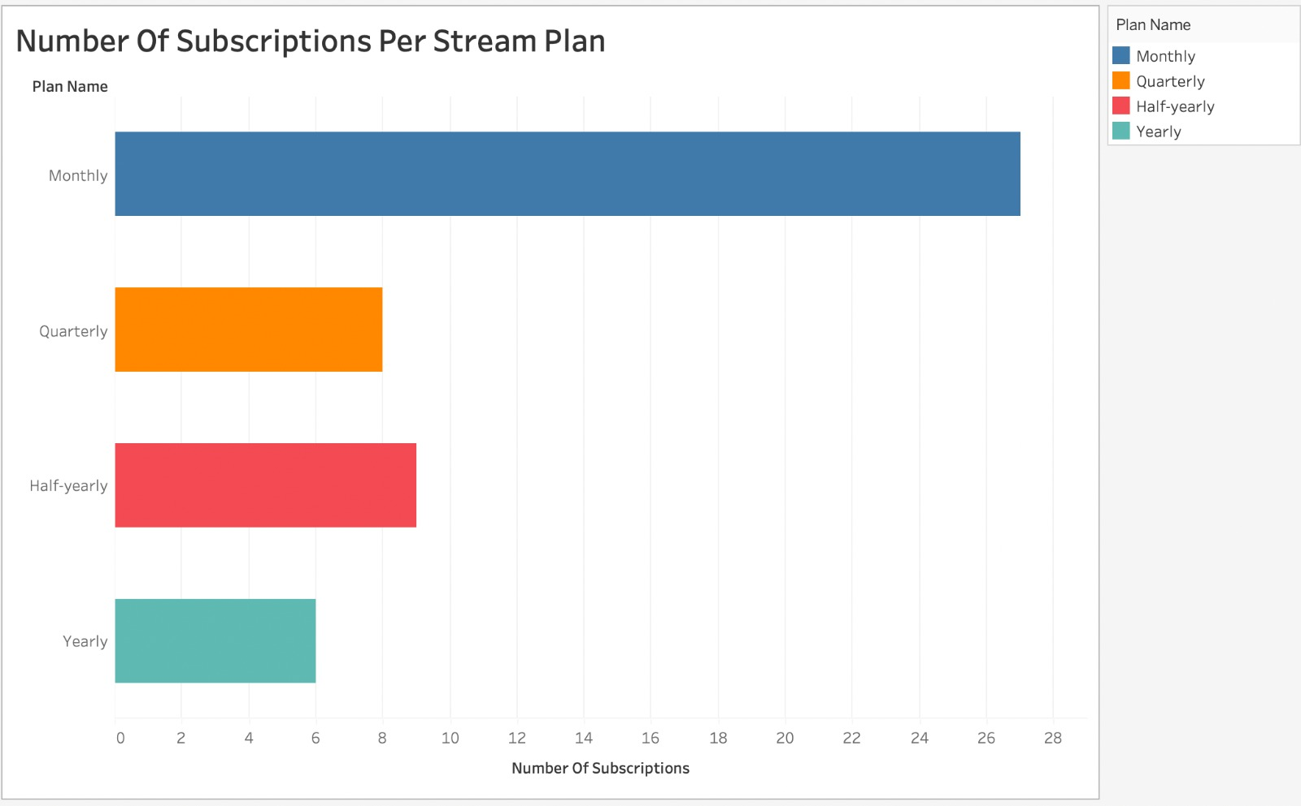
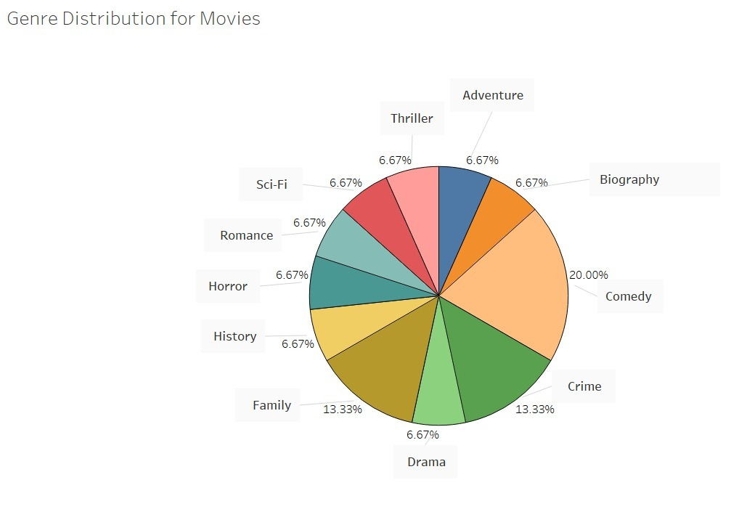
Reports & Visualization
Number of Subscriptions Per Stream Plan
Genre Distribution for Movies

Slide 14
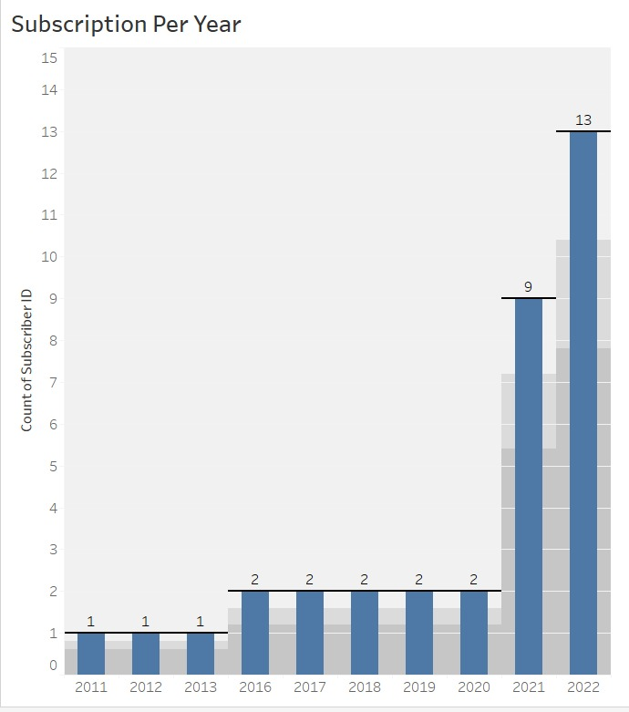
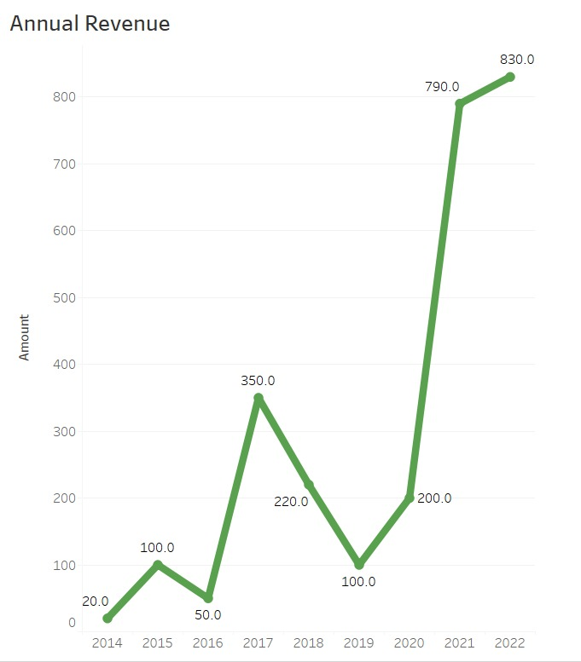
Reports & Visualization
Subscriptions Per Year
Annual Revenue

Slide 15
Future scope
Third-party payment gateways
Recommendation system
Global expansion
Group Viewing
Live-streaming

Slide 16

Thank You!

